Slide 1
ICE 3131: Java and Network Programming
Third Year Odd Semester
Department of Information and Communication Engineering
University of Rajshahi
By
Md. Emdadul Haque
Prof. Dept of ICE, RU

Slide 2
ICE 3131: Java and Network Programming
75 Marks [70% Exam, 20% Quizzes/Class Tests, 10% Attendance]
3 Credits, 3 Hours/week, Lectures: 39, Exam time: 3 Hours

Slide 3
Course Objectives:
The course is design to extend student knowledge in object-oriented programming such as class, object, method and constructor. This course also focuses on graphical user interface (GUI), multithreading, networking and database manipulation.

Slide 4
Course Contents: Section – A
Introduction to Java: History of Java, Java features and advantages, Class, Object, Abstraction, Encapsulation, Inheritance, Polymorphism, Creating classes with Java, Concept of constructors, Using JDK, Data types, Arrays, Operators and control flow.
Methods: Using methods, declaring a class method, Implementation of inheritance, calling a class method, Passing parameters, Variables, Local variables and variable scope.
Using Standard Java Packages: Creating graphical user interfaces with AWT, Managing graphics objects with GUI layout managers, Event handling of various components.
Exception Handling: Overview of exception handling, the basic model, Hierarchy of event classes, Throw clause, throws statement, try-catch block.
Section – B
Managing Input/Output Files in Java: Introduction, Concept of streams, Stream classes; Byte stream class, Character stream class, Other useful I/O classes, Using the file class.
Thread: Introduction, Multithread, Synchronization, Deadlock.
Socket Programming: Socket basics, Socket-based network concepts, Client server basics, Socket for client, Socket for server.
Java Database Connectivity: JDBC, JDBC drivers, the JAVA.sql packages, SQL, JDBC connection and executing SQL.

Slide 5
Reference Books:
Y. Daniel Liang | Introduction to JAVA Programming
Herbert Schildt | The Complete Reference of Java 2

Slide 6
Assessment and Evaluation Strategy:
Class tests/Assignments/Quizzes/Programming contest
Class test 1 (50% of CA marks)
Assignments/Quizzes/Presentation 1 (50% of CA marks)
Class attendance (10%)
Final exam (70%)

Slide 7

Managing Input/Output Files in Java

Slide 8
Outlines of Presentation
Introduction
Concept of streams
Stream classes
Byte stream class
Character stream class
Other useful I/O classes
Using the file class

Slide 9
Introduction
Generally we use variables and arrays for storing data inside the programs
This approach has the following problems
The data is lost either when a variable goes out of scope or when the programs terminated, that is the storage is temporary
It is difficult to handle large volume of data using variables and arrays
We can overcome these problem by storing data on secondary storage device such as hard disk
The data is stored in these devise using the concept of files

Slide 10
Introduction
A file is a collection of related records places in a particular area on a disk
A record is composed of several fields and a field is a group of characters
Characters in Java are Unicode characters composed of two bytes, each byte containing eight binary digits, 1 or 0

Slide 11
Introduction
Storing and managing data using files is known as file processing
File processing includes the following task
Creating files
Updating files and
Manipulation of data
Java supports many powerful features for managing input and output of data using files

Slide 12
Introduction
Reading and writing of data in a file can be done-
At the level of bytes or characters or fields depending on the requirement of a particular applications
Java also provides capabilities to read and write class object directly
The process of reading and writing object is called object serialization

Slide 13
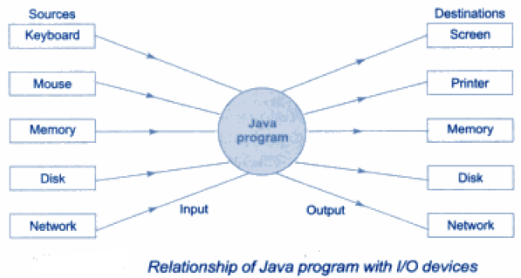
Introduction
In file processing.
Input refers to the flow of data into a program and
Output means the flow of data out of a program
Input to a program may come form the key board, the mouse, the memory, the disk, a network or another program
Similarly output from a program may go to the screen, the printer, the memory, the disk, a network, or another program

Slide 14
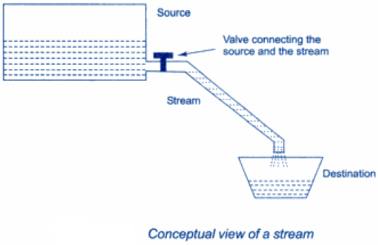
Concept of Streams
A streams presents a uniform, easy-to-use, object oriented interface between the program and the input/output device
A stream in Java is a path along which data flows (like a river or a pipe along which water flows)
It has a source (of data) and destination (for that data)
Both the source and destination may be physical devices or programs or other steams in the same program

Slide 15
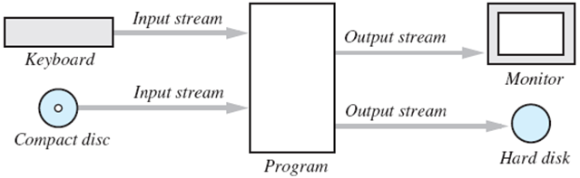
Concept of Streams
Stream is an object that either delivers data to its destination (ex: screen, file) or that takes data from a source (ex: keyboard, file)
It acts as a buffer between the data source and destination
Streams are channel for sending and receiving information in java program
When sending a stream of data, it is said that it is writing a stream
When receiving a stream of data, it is said that it is reading a stream

Slide 16
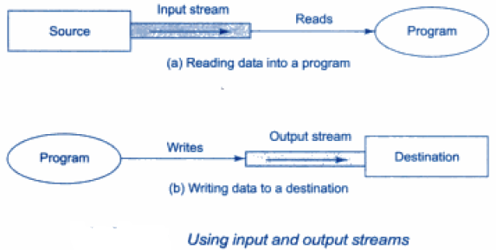
Concept of Streams
Java streams are classified into two basic types
Input stream
An input stream extracts (i.e reads) data from the source (file) and sends it to the program
Output stream
Similarly, an output stream takes data from the program and sends (i.e write) it to the destination file

Slide 17
Stream Classes
The Java.io package contains a large number of stream classes
It provides capabilities for processing all types of data
These classes may be categorized into two groups based on the data types on which they operate
Byte stream class that provide support for handling I/O operation on bytes
Character stream classes that provide support for managing I/O operation on character
These two groups may further be classified based on their purpose

Slide 18
Byte Stream Classes
Byte stream classes have been designed
To provide functional features for creating and manipulating streams and files for reading and writing bytes
Since the streams are unidirectional, they can transmit bytes in only one direction
Therefore Java provides two kind of byte stream classes
Input stream classes and
Output stream classes

Slide 19
Input Stream Classes
Input stream classes are used to read 8-bit bytes include a super class known as InputStream
It is also used to read 8-bit bytes include a number of subclasses for supporting various input related functions
The super class InputStram is abstract class, and therefore, we cannot create instances of this class
Rather, we must use the subclasses that inherit from this class

Slide 20
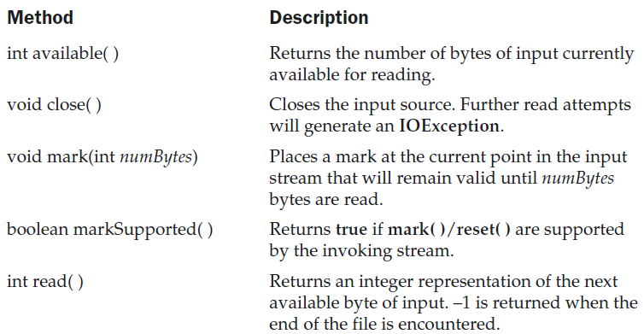
Input Stream Classes
InputStream is an abstract class that defines Java’s model of streaming byte input. All of the methods in this class will throw an IOException on error conditions. Table 17-1
shows the methods in InputStream.

Slide 21
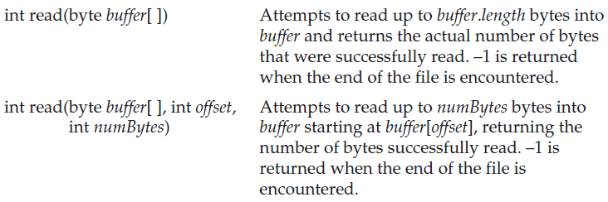
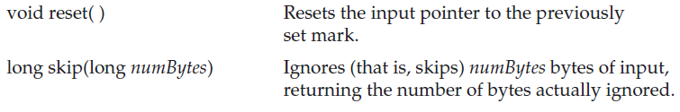
Input Stream Classes
Method Description

Slide 22
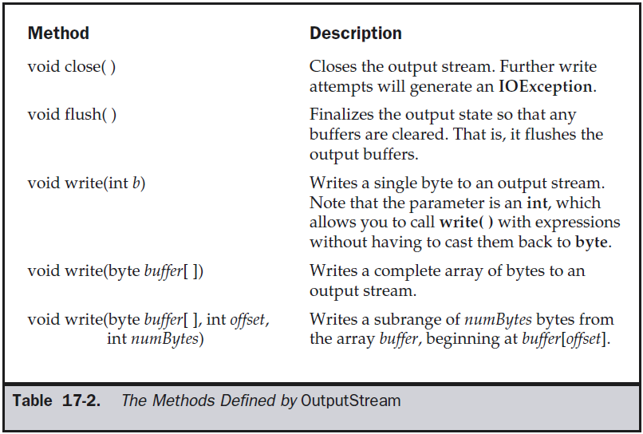
Output Stream Classes
OutputStream is an abstract class that defines streaming byte output. All of the methods in this class return a void value and throw an IOException in the case of errors. Table 17-2 shows the methods in OutputStream.

Slide 23
FileInputStream Classes
The FileInputStream class creates an InputStream that you can use to read bytes from a file. Its two most common constructors are shown here:
FileInputStream(String filepath)
FileInputStream(File fileObj)
Either can throw a FileNotFoundException.
Here, filepath is the full path name of a file, and fileObj is a File object that describes the file.

Slide 24
FileInputStream Classes
The next example shows how to read a single byte, an array of bytes, and a subrange array of bytes. The program reads its own source file, which must be in the current directory.

Slide 25
FileInputStream Classes
// Demonstrate FileInputStream.
import java.io.*;
class FileInputStreamDemo {
public static void main(String args[]) throws Exception {
int size;
InputStream f = new FileInputStream("FileInputStreamDemo.java");
System.out.println("Total Available Bytes: " +
(size = f.available()));
int n = size/40;
System.out.println("First " + n +
" bytes of the file one read() at a time");
for (int i=0; i < n; i++) {
System.out.print((char) f.read());
}
System.out.println("\nStill Available: " + f.available());
System.out.println("Reading the next " + n +
" with one read(b[])");
byte b[] = new byte[n];
if (f.read(b) != n) {
System.err.println("couldn't read " + n + " bytes.");
}
System.out.println(new String(b, 0, n));
System.out.println("\nStill Available: " + (size = f.available()));
System.out.println("Skipping half of remaining bytes with skip()");
f.skip(size/2);
System.out.println("Still Available: " + f.available());
System.out.println("Reading " + n/2 + " into the end of array");
if (f.read(b, n/2, n/2) != n/2) {
System.err.println("couldn't read " + n/2 + " bytes.");
}
System.out.println(new String(b, 0, b.length));
System.out.println("\nStill Available: " + f.available());
f.close();
}
}

Slide 26
FileInputStream Classes
Output:
Total Available Bytes: 1433
First 35 bytes of the file one read() at a time
// Demonstrate FileInputStream.
im
Still Available: 1398
Reading the next 35 with one read(b[])
port java.io.*;
class FileInputS
Still Available: 1363
Skipping half of remaining bytes with skip()
Still Available: 682
Reading 17 into the end of array
port java.io.*;
read(b) != n) {
S
Still Available: 665

Slide 27
FileOutputStream Classes
FileOutputStream creates an OutputStream that you can use to write bytes to a file. Its most commonly used constructors are shown here:
FileOutputStream(String filePath)
FileOutputStream(File fileObj)
FileOutputStream(String filePath, boolean append)
FileOutputStream(File fileObj, boolean append)
They can throw a FileNotFoundException or a SecurityException. Here, filePath is the full path name of a file, and fileObj is a File object that describes the file. If append is true, the file is opened in append mode. The fourth constructor was added by Java 2, version 1.4.

Slide 28
FileOutputStream Classes
// Demonstrate FileOutputStream.
import java.io.*;
class FileOutputStreamDemo {
public static void main(String args[]) throws Exception {
String source = "Now is the time for all good men\n"
+ " to come to the aid of their country\n"
+ " and pay their due taxes.";
byte buf[] = source.getBytes();
OutputStream f0 = new FileOutputStream("file1.txt");
for (int i=0; i < buf.length; i += 2) {
f0.write(buf[i]);
}
f0.close();
OutputStream f1 = new FileOutputStream("file2.txt");
f1.write(buf);
f1.close();
OutputStream f2 = new FileOutputStream("file3.txt");
f2.write(buf,buf.length-buf.length/4,buf.length/4);
f2.close();
}
}

Slide 29
FileOutputStream Classes
Here are the contents of each file after running this program. First, file1.txt:
Nwi h iefralgo e
t oet h i ftercuty n a hi u ae.
Next, file2.txt:
Now is the time for all good men
to come to the aid of their country
and pay their due taxes.
Finally, file3.txt:
nd pay their due taxes.

Slide 30
Byte Stream Classes
ByteArrayInputStream
ByteArrayInputStream is an implementation of an input stream that uses a byte array as the source. This class has two constructors, each of which requires a byte array to provide the data source:
ByteArrayInputStream(byte array[ ])
ByteArrayInputStream(byte array[ ], int start, int numBytes)
Here, array is the input source. The second constructor creates an InputStream from a subset of your byte array that begins with the character at the index specified by start and is numBytes long.

Slide 31
Byte Stream Classes
ByteArrayInputStream
ByteArrayInputStream is an implementation of an input stream that uses a byte array as the source. This class has two constructors, each of which requires a byte array to provide the data source:
ByteArrayInputStream(byte array[ ])
ByteArrayInputStream(byte array[ ], int start, int numBytes)
Here, array is the input source. The second constructor creates an InputStream from a subset of your byte array that begins with the character at the index specified by start and is numBytes long.

Slide 32
Byte Stream Classes
ByteArrayOutputStream
ByteArrayOutputStream is an implementation of an output stream that uses a byte array as the destination. ByteArrayOutputStream has two constructors, shown here:
ByteArrayOutputStream( )
ByteArrayOutputStream(int numBytes)
In the first form, a buffer of 32 bytes is created. In the second, a buffer is created with a size equal to that specified by numBytes. The buffer is held in the protected buf field of ByteArrayOutputStream. The buffer size will be increased automatically, if needed. The number of bytes held by the buffer is contained in the protected count field of ByteArrayOutputStream.

Slide 33
RandomAccessFile Classes
All of the streams you have used so far are known as read-only or write-only streams. These streams are called sequential streams.
A file that is opened using a sequential stream is called
a sequential-access file.
The contents of a sequential-access file cannot be updated. However, it is often necessary to modify files.
Java provides the RandomAccessFile class to allow data to be read from and written to at any locations in a file. A file that is opened using the RandomAccessFile class is known as a random-access file.

Slide 34
RandomAccessFile Classes
All of the streams you have used so far are known as read-only or write-only streams. These streams are called sequential streams.
A file that is opened using a sequential stream is called
a sequential-access file.
The contents of a sequential-access file cannot be updated. However, it is often necessary to modify files.
Java provides the RandomAccessFile class to allow data to be read from and written to at any locations in a file. A file that is opened using the RandomAccessFile class is known as a random-access file.

Slide 35
RandomAccessFile Classes
When creating a RandomAccessFile, you can specify one of two modes: r or rw. Mode r means that the stream is read-only, and mode rw indicates that the stream allows both read
and write. For example, the following statement creates a new stream, raf, that allows the program to read from and write to the file test.dat:
RandomAccessFile raf = new RandomAccessFile("test.dat","rw");

Slide 36
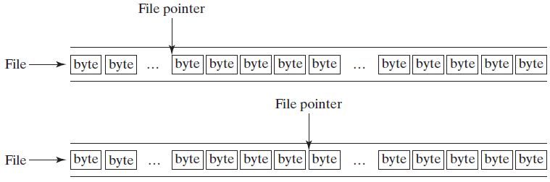
RandomAccessFile Classes
A random-access file consists of a sequence of bytes. A special marker called a file pointer is positioned at one of these bytes. A read or write operation takes place at the location of the file pointer. When a file is opened, the file pointer is set at the beginning of the file. When you read or write data to the file, the file pointer moves forward to the next data item.
Example:
(a) Before readInt():
(b) After readInt():

Slide 37
RandomAccessFile Classes
For a RandomAccessFile raf, you can use the raf.seek(position) method to move the file pointer to a specified position. raf.seek(0) moves it to the beginning of the file, and raf.seek(raf.length()) moves it to the end of the file.

Slide 38
RandomAccessFile Classes
import java.io.*;
public class TestRandomAccessFile {
public static void main(String[] args) throws IOException {
try ( // Create a random access file
RandomAccessFile inout = new RandomAccessFile("inout.dat", "rw");
) {
// Clear the file to destroy the old contents if exists
inout.setLength(0);
// Write new integers to the file
for (int i = 0; i < 200; i++)
inout.writeInt(i);
// Display the current length of the file
System.out.println("Current file length is " + inout.length());
// Retrieve the first number
inout.seek(0); // Move the file pointer to the beginning
System.out.println("The first number is " + inout.readInt());
// Retrieve the second number
inout.seek(1 * 4); // Move the file pointer to the second number
System.out.println("The second number is " + inout.readInt());

Slide 39
RandomAccessFile Classes
// Retrieve the tenth number
inout.seek(9 * 4); // Move the file pointer to the tenth number
System.out.println("The tenth number is " + inout.readInt());
// Modify the eleventh number
inout.writeInt(555);
// Append a new number
inout.seek(inout.length()); // Move the file pointer to the end
inout.writeInt(999);
// Display the new length
System.out.println("The new length is " + inout.length());
// Retrieve the new eleventh number
inout.seek(10 * 4); // Move the file pointer to the eleventh number
System.out.println("The eleventh number is " + inout.readInt());
}
}
}

Slide 40
RandomAccessFile Classes
Output
Current file length is 800
The first number is 0
The second number is 1
The tenth number is 9
The new length is 804
The eleventh number is 555

Slide 41
The Character Streams
While the byte stream classes provide sufficient functionality to handle any type of I/O operation, they cannot work directly with Unicode characters.
Reader
Reader is an abstract class that defines Java’s model of streaming character input. All of the methods in this class will throw an IOException on error conditions. Table 17-3
provides a synopsis of the methods in Reader.

Slide 42
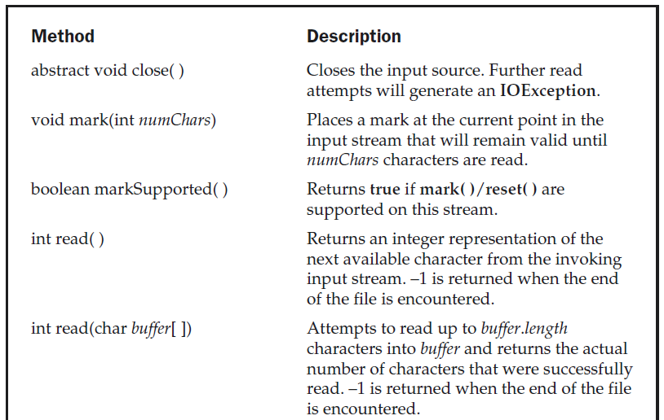
The Character Streams

Slide 43
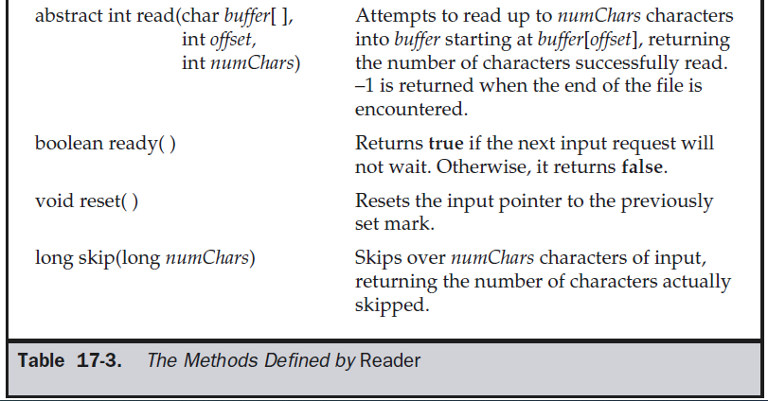
The Character Streams

Slide 44
The Character Streams
FileReader
The FileReader class creates a Reader that you can use to read the contents of a file. Its two most commonly used constructors are shown here:
FileReader(String filePath)
FileReader(File fileObj)
Either can throw a FileNotFoundException. Here, filePath is the full path name of a file, and fileObj is a File object that describes the file.

Slide 45
The Character Streams
FileReader
Example shows how to read lines from a file and print these to the standard output stream:
// Demonstrate FileReader.
import java.io.*;
class FileReaderDemo {
public static void main(String args[]) throws Exception {
FileReader fr = new FileReader("FileReaderDemo.java");
BufferedReader br = new BufferedReader(fr);
String s;
while((s = br.readLine()) != null) {
System.out.println(s);
}
fr.close();
} }

Slide 46
The Character Streams
Writer
Writer is an abstract class that defines streaming character output. All of the methods in this class return a void value and throw an IOException in the case of errors. Table 17-4 shows a synopsis of the methods in Writer.

Slide 47
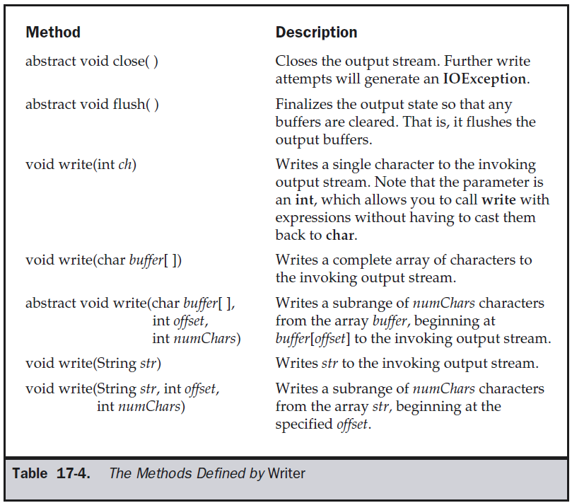
The Character Streams

Slide 48
The Character Streams
FileWriter creates a Writer that you can use to write to a file. Its most commonly used constructors are shown here:
FileWriter(String filePath)
FileWriter(String filePath, boolean append)
FileWriter(File fileObj)
FileWriter(File fileObj, boolean append)
They can throw an IOException. Here, filePath is the full path name of a file, and fileObj is a File object that describes the file. If append is true, then output is appended to the end of the file. The fourth constructor was added by Java 2, version 1.4.

Slide 49
The Character Streams
The following example is a character stream version of an example shown earlier when FileOutputStream was discussed.
This version creates a sample buffer of characters by first making a String and then using the getChars( ) method to extract the character array equivalent. It then creates three files.

Slide 50
The Character Streams
FileWriter f0=new FileWriter("file1.txt");
for (int i=0; i < buffer.length; i += 2) {
f0.write(buffer[i]);
}
f0.close();
FileWriter f1 = new FileWriter("file2.txt");
f1.write(buffer);
f1.close();
FileWriter f2 = new FileWriter("file3.txt");
f2.write(buffer,buffer.length-buffer.length/4,buffer.length/4);
f2.close();
}
}
// Demonstrate FileWriter.
import java.io.*;
class FileWriterDemo {
public static void main(String args[]) throws Exception {
String source = "Now is the time for all good men\n“ + " to come to the aid of their country\n" + " and pay their due taxes.";
char buffer[] = new char[source.length()];
source.getChars(0, source.length(), buffer, 0);

Slide 51
The Character Streams
CharArrayReader
CharArrayReader is an implementation of an input stream that uses a character array as the source. This class has two constructors, each of which requires a character array
to provide the data source:
CharArrayReader(char array[ ])
CharArrayReader(char array[ ], int start, int numChars)
Here, array is the input source. The second constructor creates a Reader from a subset of your character array that begins with the character at the index specified by start and is numChars long.

Slide 52
The Character Streams
CharArrayWriter
CharArrayWriter is an implementation of an output stream that uses an array as the destination. CharArrayWriter has two constructors, shown here:
CharArrayWriter( )
CharArrayWriter(int numChars)
In the first form, a buffer with a default size is created. In the second, a buffer is created with a size equal to that specified by numChars. The buffer is held in the buf field of CharArrayWriter. The buffer size will be increased automatically, if needed. The number of characters held by the buffer is contained in the count field of CharArrayWriter. Both buf and count are protected fields.

Slide 53
Byte Stream vs. Character Stream
Byte Stream | Character Stream
They process the data byte by byte. | They process the data character by character.
They read/write data 8 bits maximum at a time. | They read/write data 16 bits maximum at a time.
They are most suitable to process binary files. | They are most suitable to process text files.
All byte stream classes in Java are descendants of InputStream and OutputStream. | All character stream classes in Java are descendants of Reader and Writer.

Slide 54
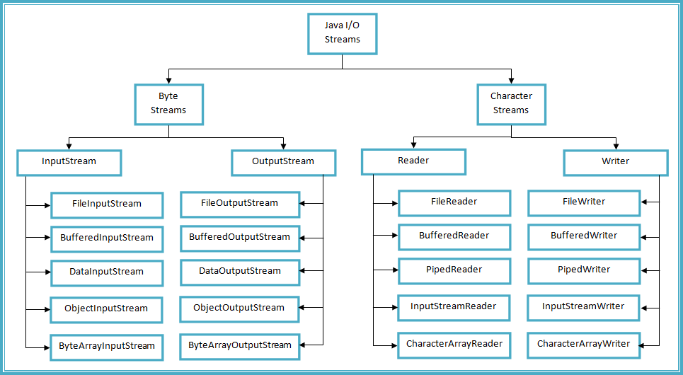
Byte Stream vs. Character Stream

Slide 55
File
Although most of the classes defined by java.io operate on streams, the File class does not. It deals directly with files and the file system. That is, the File class does not specify how information is retrieved from or stored in files; it describes the properties of a file itself.
A File object is used to obtain or manipulate the information associated with a disk file, such as the permissions, time, date, and directory path, and to navigate subdirectory hierarchies.

Slide 56
File
The following constructors can be used to create File objects:
File(String directoryPath)
File(String directoryPath, String filename)
File(File dirObj, String filename)
File(URI uriObj)
Here, directoryPath is the path name of the file, filename is the name of the file, dirObj is a File object that specifies a directory, and uriObj is a URI object that describes a file. The fourth constructor was added by Java 2, version 1.4.

Slide 57
File
The following example creates three files: f1, f2, and f3.
The first File object is constructed with a directory path as the only argument.
The second includes two arguments—the path and the filename.
The third includes the file path assigned to f1 and a filename; f3 refers to the same file as f2.
File f1 = new File("/java");
File f2 = new File("/java","autoexec.bat");
File f3 = new File(f1,"autoexec.bat");

Slide 58
File
File defines many methods that obtain the standard properties of a File object.
For example, getName( ) returns the name of the file,
getParent( ) returns the name of the parent directory, and
exists( ) returns true if the file exists, false if it does not.
The File class, however, is not symmetrical. By this, we mean that there are many methods that allow you to examine the properties of a simple file object, but no corresponding function exists to
change those attributes.
7
The following example demonstrates several of the File methods:

Slide 59
File
Output
File Name: COPYRIGHT
Path: /java/COPYRIGHT
Abs Path: /java/COPYRIGHT
Parent: /java
exists
is writeable
is readable
is not a directory
is normal file
is absolute
File last modified: 812465204000
File size: 695 Bytes
import java.io.File; // Demonstrate File.
class FileDemo {
static void p(String s) { System.out.println(s); }
public static void main(String args[]) {
File f1 = new File("/java/COPYRIGHT");
p("File Name: " + f1.getName());
p("Path: " + f1.getPath());
p("Abs Path: " + f1.getAbsolutePath());
p("Parent: " + f1.getParent());
p(f1.exists() ? "exists" : "does not exist");
p(f1.canWrite() ? "is writeable" : "is not writeable");
p(f1.canRead() ? "is readable" : "is not readable");
p("is " + (f1.isDirectory() ? "" : "not" + " a directory"));
p(f1.isFile() ? "is normal file" : "might be a named pipe");
p(f1.isAbsolute() ? "is absolute" : "is not absolute");
p("File last modified: " + f1.lastModified());
p("File size: " + f1.length() + " Bytes");
} }

Slide 60
File
Output
File Name: COPYRIGHT
Path: /java/COPYRIGHT
Abs Path: /java/COPYRIGHT
Parent: /java
exists
is writeable
is readable
is not a directory
is normal file
is absolute
File last modified: 812465204000
File size: 695 Bytes

Slide 61
File
File also includes two useful utility methods. The first is renameTo( ), shown here:
boolean renameTo(File newName)
It will return true upon success and false if the file cannot be renamed.
The second utility method is delete( ), which deletes the disk file represented by the path of the invoking File object. It is shown here:
boolean delete( )
You can also use delete( ) to delete a directory if the directory is empty. delete( ) returns true if it deletes the file and false if the file cannot be removed.

Slide 62
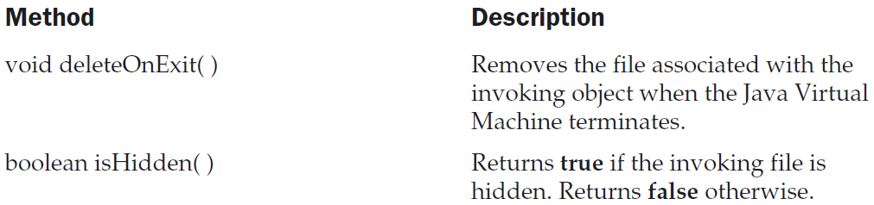
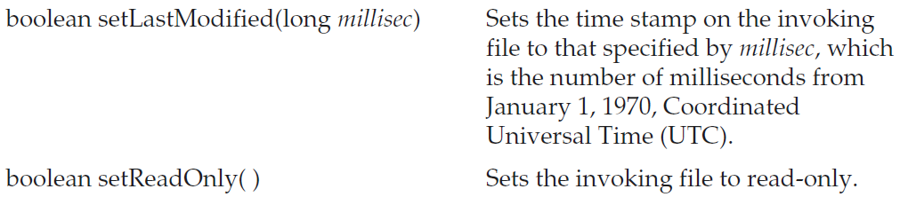
File
Here are some other File methods that you will find helpful.

Slide 63
File
Directories
A directory is a File that contains a list of other files and directories. When you create a File object and it is a directory, the isDirectory( ) method will return true. In this case, you can call list( ) on that object to extract the list of other files and directories inside. It has two forms. The first is shown here:
String[ ] list( )
The list of files is returned in an array of String objects.

Slide 64
File
// Using directories.
import java.io.File;
class DirList {
public static void main(String args[]) {
String dirname = "/java";
File f1 = new File(dirname);
if (f1.isDirectory()) {
System.out.println("Directory of " + dirname);
String s[] = f1.list();
for (int i=0; i < s.length; i++) {
File f = new File(dirname + "/" + s[i]);
if (f.isDirectory()) {
System.out.println(s[i] + " is a directory");
} else {

Slide 65
File
System.out.println(s[i] + " is a file");
}
}
} else {
System.out.println(dirname +
" is not a directory");
}
}
}
Output
Directory of /java
bin is a directory
lib is a directory
demo is a directory
COPYRIGHT is a file
README is a file
index.html is a file
include is a directory
src.zip is a file
.hotjava is a directory
src is a directory

Slide 66
File
Using FilenameFilter
You will often want to limit the number of files returned by the list( ) method to include only those files that match a certain filename pattern, or filter. To do this, you must use a second form of list( ), shown here:
String[ ] list(FilenameFilter FFObj)
FilenameFilter defines only a single method, accept( ), which is called once for each file in a list. Its general form is given here:
boolean accept(File directory, String filename)
The accept( ) method returns true for files in the directory specified by directory that should be included in the list, and returns false for those files that should be excluded.

Slide 67
File
The OnlyExt class, shown next, implements FilenameFilter. It will be used to modify the preceding program so that it restricts the visibility of the filenames returned by list( )
to files with names that end in the file extension specified when the object is constructed.
import java.io.*;
public class OnlyExt implements FilenameFilter {
String ext;
public OnlyExt(String ext) {
this.ext = "." + ext;
}
public boolean accept(File dir, String name) {
return name.endsWith(ext);
}
}

Slide 68
File
The modified directory listing program is shown here. Now it will only display files
that use the .html extension.
// Directory of .HTML files.
import java.io.*;
class DirListOnly {
public static void main(String args[]) {
String dirname = "/java";
File f1 = new File(dirname);
FilenameFilter only = new OnlyExt("html");
String s[] = f1.list(only);
for (int i=0; i < s.length; i++) {
System.out.println(s[i]);
} }
}

Slide 69
Serialization
Serialization is the process of writing the state of an object to a byte stream. This is useful when you want to save the state of your program to a persistent storage area, such as a file. At a later time, you may restore these objects by using the process of deserialization.

Slide 70
Serialization
Assume that an object to be serialized has references to other objects, which, in turn, have references to still more objects. This set of objects and the relationships
among them form a directed graph.
The object serialization and deserialization facilities have been designed to work correctly in these scenarios.

Slide 71
Serialization
If you attempt to serialize an object at the top of an object
graph, all of the other referenced objects are recursively located and serialized.
Similarly, during the process of deserialization, all of these objects and their references are correctly restored.

Slide 72
Serialization
Serializable
Only an object that implements the Serializable interface can be saved and restored by the serialization facilities. The Serializable interface defines no members. It is simply used to indicate that a class may be serialized. If a class is serializable, all of its
subclasses are also serializable.
Variables that are declared as transient are not saved by the serialization facilities. Also, static variables are not saved.

Slide 73
Serialization
Externalizable
Sometimes the programmer may need to have control over these processes. For example, it may be desirable to use compression or encryption techniques. The Externalizable interface is designed for these situations.
The Externalizable interface defines these two methods:
void readExternal(ObjectInput inStream)
throws IOException, ClassNotFoundException
void writeExternal(ObjectOutput outStream)
throws IOException
In these methods, inStream is the byte stream from which the object is to be read, and outStream is the byte stream to which the object is to be written.

Slide 74
Serialization
ObjectOutput
The ObjectOutput interface extends the DataOutput interface and supports object serialization. It defines the methods shown in Table 20-6. Note especially the writeObject( ) method. This is called to serialize an object. All of these methods will throw an IOException on error conditions.

Slide 75
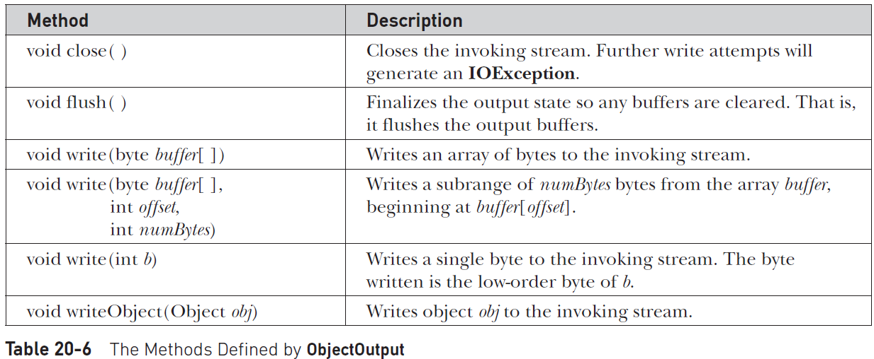
Serialization
ObjectOutput

Slide 76
Serialization
ObjectOutputStream
The ObjectOutputStream class extends the OutputStream class and implements the ObjectOutput interface. It is responsible for writing objects to a stream. A constructor
of this class is
ObjectOutputStream(OutputStream outStream) throws
IOException
The argument outStream is the output stream to which serialized objects will be written.
The most commonly used methods in this class are shown in Table 20-7. They will throw an IOException on error conditions.

Slide 77
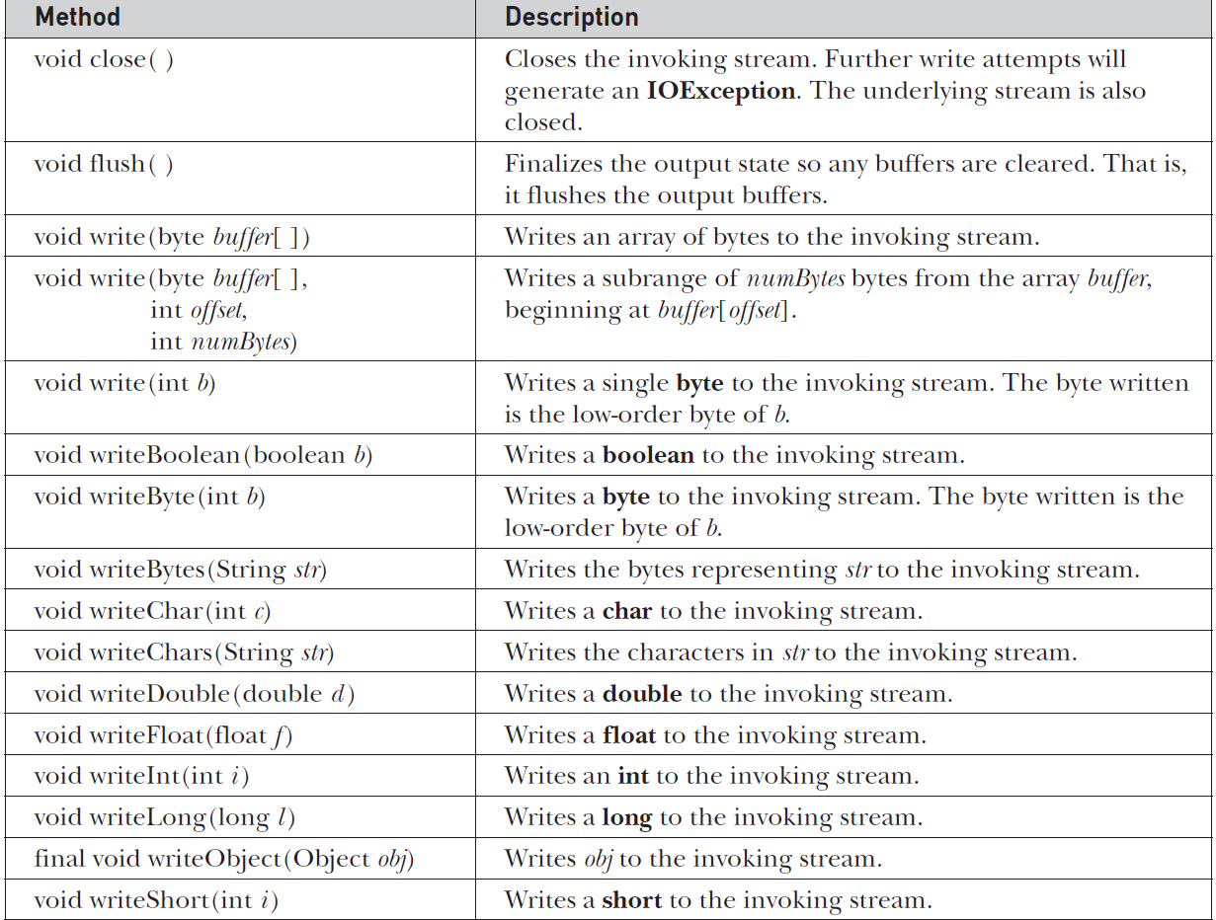
Serialization
ObjectOutputStream

Slide 78
Serialization
ObjectInput
The ObjectInput interface extends the DataInput interface and defines the methods shown in Table 20-8. It supports object serialization. Note especially the readObject( ) method. This is called to deserialize an object. All of these methods will throw an
IOException on error conditions.

Slide 79
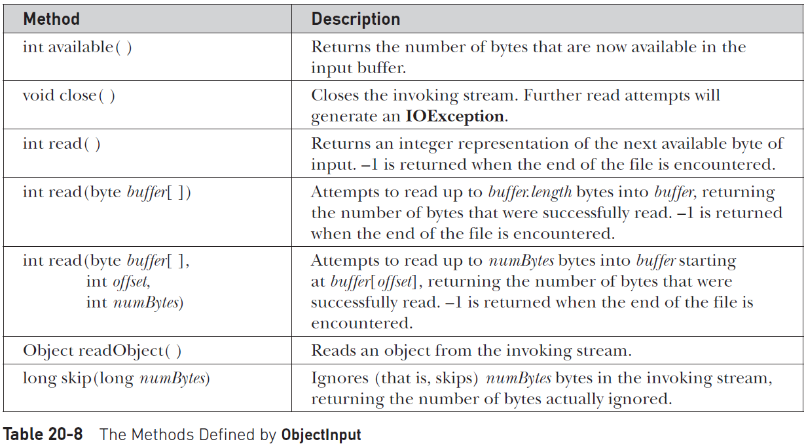
Serialization
ObjectInput

Slide 80
Serialization
ObjectInputStream
The ObjectInputStream class extends the InputStream class and implements the ObjectInput interface. ObjectInputStream is responsible for reading objects from a stream. A constructor of this class is
ObjectInputStream(InputStream inStream)
throws IOException, StreamCorruptedException
The argument inStream is the input stream from which serialized objects should be read. The most commonly used methods in this class are shown in Table 17-8.

Slide 81
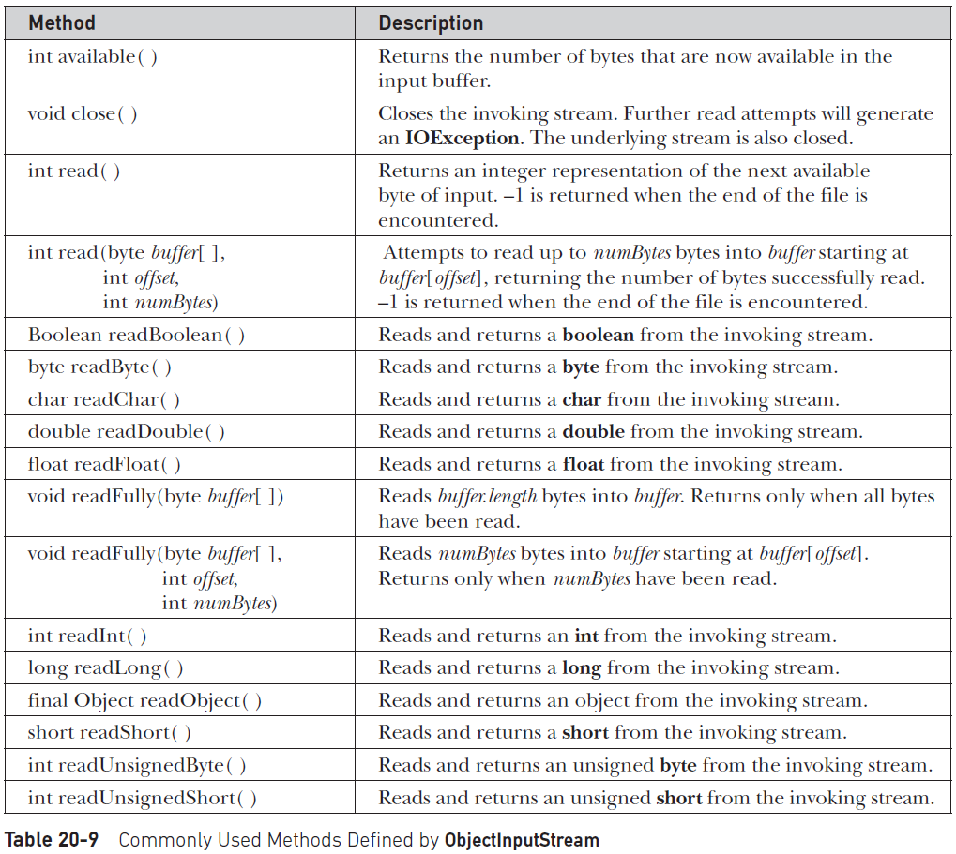
Serialization
ObjectInputStream

Slide 82
Serialization
A Serialization Example
An example of object serialization and deserialization of class MyClass. This object has three instance variables that are of types String, int, and double that we want to save and restore.
Note that MyClass is defined to implement the Serializable interface. If this is not done, a NotSerializableException is thrown.

Slide 83
Serialization
A Serialization Example
// A serialization demo. It requires JDK 7 or later.
import java.io.*;
public class SerializationDemo {
public static void main(String args[]) {
// Object serialization
try ( ObjectOutputStream objOStrm = new ObjectOutputStream(new FileOutputStream("serial")) )
{
MyClass object1 = new MyClass("Hello", -7, 2.7e10);
System.out.println("object1: " + object1);
objOStrm.writeObject(object1);
}
catch(IOException e) {
System.out.println("Exception during serialization: " + e);
}

Slide 84
Serialization
A Serialization Example
// Object deserialization
try ( ObjectInputStream objIStrm = new ObjectInputStream(new FileInputStream("serial")) )
{
MyClass object2 = (MyClass)objIStrm.readObject();
System.out.println("object2: " + object2);
}
catch(Exception e) {
System.out.println("Exception during deserialization: " + e);
}
}
}

Slide 85

Serialization
A Serialization Example
class MyClass implements Serializable {
String s;
int i;
double d;
public MyClass(String s, int i, double d) {
this.s = s;
this.i = i;
this.d = d;
}
public String toString() {
return "s=" + s + "; i=" + i + "; d=" + d;
}
}
Output

